Slide 1

VIRTUAL INTELLIGENCE DIRECTORATE
x
OMNIA VINCIT SAPIENTIA
Generic Air Force structure
INTREP VID-B-002
NOTE: Virtual Intelligence Service (VIS) is a fictive intelligence organization created to increase immersion in missions and campaigns hosted and organized by the 132nd Virtual Wing, using DCS (Digital Combat Simulator).
Version: 2.1
Published: 2023-05-18
Notes:
Verson 0.1: Draft 1

Slide 2
Introduction
This report is part of the basic intelligence for 132nd hosted events.
The aim of this report is help pilots understand the organization and structure of enemy air forces.
The structure in this document is generic and the actual structure in a operation is given as intelligence for that operation.
Back to content
Back to Air Force

Slide 3
Version control
Version number | Date | Information changed
0.1 (DRAFT) | 2020-04-26 | Initial version
0.2 | 2020-04-27 | Added Squadron description Added SEAD/EW regiment
0.3 | 2020-05-06 | Fixed formatting
1.0 | 2020-05-07 | Official release
2.0 | 2021-11-17 | Changed from VIS to VID, added Chinese jets
2.1 | 2023-05-18 | Updated H-6J to also include strategic bomber
Back to content
Back to Air Force

Slide 4
Content
Aircraft roles
Squadron description
Squadron composition
Readiness
Hierarchy
Air Force organization
Back to content
Back to Air Force
4

Slide 5
Aircraft roles
Aircraft | Primary role | Secondary role | Name | Year
MiG-21 | Interceptor |  | FISHBED | 1959
MiG-23 | Fighter |  | FLOGGER | 1970
MiG-25 PD | Interceptor |  | FOXBAT A | 1970
MiG-25 RBT | Reconnaissance | Bomber | FOXBAT B | 1970
MiG-27K | Ground attack |  | FLOGGER D/J | 1975
MiG-29A | Fighter | Ground attack | FULCRUM | 1982
MiG-29S | Fighter | Ground attack | FULCRUM-S | 1982
MiG-31 | Interceptor |  | FOXHOUND | 1981
SU-17 M4 | Fighter bomber |  | FITTER-K | 1980
SU-24 M | Attack (A-G) |  | FENCER-D | 1979
SU-24 MR | Reconnaissance |  | FENCER-E | 1980
SU-25 | CAS | SEAD | FROGFOOT | 1981
SU-25 T | Anti-tank |  | FROGFOOT | 1991
SU-25 TM | Attack |  | FROGFOOT | 2008
SU-27 | Fighter | Fighter escort | FLANKER | 1985
SU-30 | Fighter/attack | Deep interdiction | FLANKER-C | 1996
SU-33 | Fighter |  | FLANKER-D | 1998
SU-34 | Fighter-bomber | Strike, EW/SEAD | FULLBACK | 2006
TU-142 | ASW | Anti-ship(ASUW) | BEAR | 1972
TU-160 | Strategic bomber |  | BLACKJACK | 1987
TU-22 M3 | Strategic bomber | Anti-ship(ASUW) | BACKFIRE-C | 1972
TU-95 MS | Cruise Missiles |  | BEAR-H | 1981
A-50 | AWACS |  | MAINSTAY | 1984
AN-26 B | Transport |  | CURL | 1970
AN-30 M | Reconnaissance |  | CLANK | 1968
IL-78 M | AAR |  | MIDAS | 1987
IL-76 MD | Transport |  | CANDID | 1974
YAK-40 | VIP transport | EW | CODLING | 1968
Back to content
Back to Air Force

Slide 6
Aircraft roles
Aircraft | Primary role | Secondary role | Name | Year
H-6J | Anti-ship(ASUW) | Strategic bomber |  | 1959
J-11B | Fighter | Fighter escort | FLANKER L | 1998
J-15B (Carrier) | Fighter/attack | Anti-ship(ASUW) | FLANKER X2 | 2009
J-16 07 BATCH | Fighter-bomber |  |  | 2015
J-16D | Electronic warfare | SEAD |  | 2015
J-20 | Fighter |  |  | 2017
J-20B | Fighter |  |  | 2017
J-7D | Fighter |  | FISHCAN | 1966
JF-17 | Fighter/attack |  |  | 2007
KJ-2000 | AWACS
KJ-600 (Carrier) | AWACS
WING LOONG1 | Reconnaissance
Back to content
Back to Air Force

Slide 7
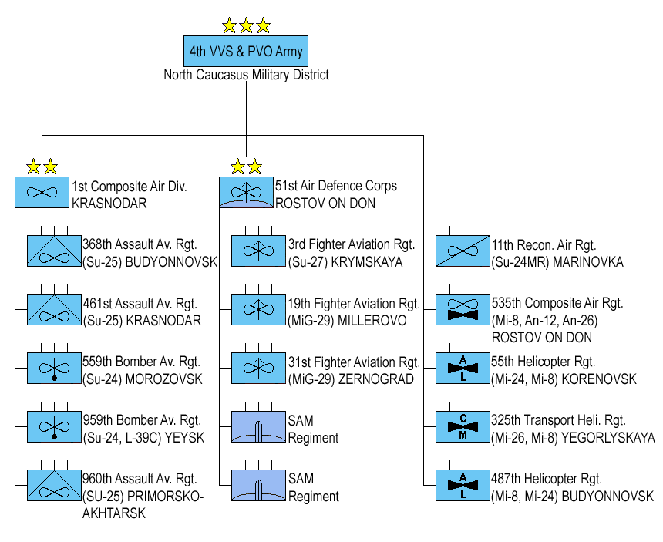
Squadron Description
Bomber
A bomber squadron conduct Air Interdiction missions. The aircraft in a bomber squadron have a limited A-A capability for self-protection. A squadron consist of 12x aircrafts.
Fighter
The fighter squadrons conduct normal fighter operations such as DCA (CAP) and OCA (Sweep, Escort). A squadron consist of 12x aircraft.
Air Force
Heavy bomber
Heavy bomber squadron conducts long-range strategic attacks, and heavy bombing duties. A squadron consist of 6x Aircraft.
Air Division
Assault
Assault squadrons conduct Close Air Support and Armed Recon missions. A squadron consist of 12x aircraft.
Reconnaissance
A reconnaissance squadron is used to gather intelligence about the enemy either visually or electronically. A squadron consist of 6x aircraft.
Air Regiment
Interceptor
Squadron that is specialized in DCA with the purpose of intercepting incoming enemy aircraft. Squadron consist of 12x aircraft.
Air Squadron
Tanker
Squadron conducts AAR for other aircrafts.
Squadron consist of 4x Aircraft.
Transport
A transport squadron is used for transporting supplies, personnel or material. This can either be a logistic operation or a airborne operation. Squadron consist of 6x aircraft.
Airborne Early Warning
Squadron conducts Airborne Early Warning, and can be tied into the regions IADS. A Squadron consist of 4x Aircraft.
Anti-ship
A Anti-ship squadron conducts maritime patrolling, or conducts Anti Surface Warfare (ASUW) where it attacks ships at sea. Carrier groups is their primary target. A squadron consist of 6x aircraft.
Bomber Aviation Regiment
Assault Aviation Regiment
Fighter Aviation Regiment
SEAD/EW
SEAD/EW squadrons are designed to attack Air Defense of the enemy and will normally support other operations. A squadron consist of x6 aircraft.
SU-24
SU-25
SU-27
MiG-29
Back to content
Back to Air Force

Slide 8
Squadron Composition
Bomber
SU-24 / SU-30 / SU-34
Fighter
MiG-23/MiG-29 / SU-27 / SU-30 /SU-33/J-11B/J-15B/J-16/J-20/J-7D/JF-17
Air Force
Heavy bomber
TU-160/ TU-22 /TU-95
Air Division
Assault
MiG-27/ MiG-29/SU-17/ SU-25 / SU-34
Reconnaissance
SU-24 MR/ MiG-25 RBT/ AN-30/H-6J
Air Regiment
Interceptor
MiG-21 / MiG-25 / MiG-31
Air Squadron
Tanker
IL-78
Transport
AN-26B/IL-76/YAK-40
Airborne Early Warning
A-50/KJ-2000/KJ-600
Anti-ship
TU-22 /TU-142/H-6J
Bomber Aviation Regiment
Assault Aviation Regiment
Fighter Aviation Regiment
SEAD/EW
YAK-40, SU-25, SU-24, SU-34, SU-30, J-16D
SU-24
SU-25
SU-27
MiG-29
Back to content
Back to Air Force

Slide 9
Readiness
High readiness:
A squadron with high readiness is combat ready in support of an offensive, or pre-planned need for high readiness. The squadron have conducted preventive maintenance to support combat operations.
A squadron with high readiness have 75% of the aircraft in the squadron ready for missions, with the remaining aircraft undergoing maintenance.
Example:
12x AC: 9x aircraft ready (8-10)
6x AC: 4-5x aircraft ready (3-5)
4x AC: 3x aircraft ready (2-4)
Normal readiness:
A squadron with normal readiness is combat ready, and are in combat, flying combat operations while doing maintenance of the aircrafts
A squadron with normal readiness have 50% of the aircraft in the squadron ready for missions, with the remaining aircraft undergoing maintenance.
This is the default state of the squadrons.
Example:
12x AC: 6x aircraft ready (5-8)
6x AC: 3x aircraft ready (2-4)
4 x AC: 2x aircraft ready (1-3)
Low readiness:
A squadron with low readiness is limited combat ready, after a period of combat operations (or other reasons), the squadron need to do maintainance and prepare the aircrafts and pilots for operations. In this phase the squadron only will have a limited amount of aircraft (with crew) available for combat, flying combat operations while doing maintenance of the aircrafts.
A squadron with low readiness have 25% of the aircraft in the squadron ready for missions, with the remaining aircraft undergoing maintenance.
Example:
12x AC: 3x aircraft ready (2-6)
6 x AC: 1-2x aircraft ready (0-3)
4 x AC: 1x aircraft ready (0-2)
Back to content
Back to Air Force

Slide 10
Hierarchy
Air Force
Highest echelon in a sector or country. Led by a 3-star general. Will normally have 3 Divisions.
Air Division
A Air Division may have several regiments of various types. Led by a 2-star general.
Air Regiment
A regiment have the same mission set. Each regiment have 2-4 squadrons with different types of aircraft. Led by a 1-star general.
Air Squadron
Smallest organization in the Air Forces. Consist of same type of aircraft. Equipped with 4-12 aircraft depending on type of squadron.
The enemy force may have several numbered Air Force’s in its structure (it will vary based on the campaign/event). However the numbered Air Forces will have a similar structure
Example: Russia may have the 2nd Air Force and 4th Air Force in 2 different sectors.
Back to content
Back to Air Force

Slide 11
Air Force Organization
Air Force
Air Force
Bomber Division
Air Defense Division
Composite Air Division
Bomber
Air Division
Bomber Aviation Regiment
Fighter Aviation Regiment
Tanker Aviation Regiment
Fighter
Bomber Aviation Regiment
Fighter Aviation Regiment
Transport Aviation Regiment
Air Regiment
Assault Aviation Regiment
Fighter Aviation Regiment
Reconnisance Regiment
Heavy bomber
Air Squadron
Assault Aviation Regiment
Interceptor Aviation Regiment
AEW Squadron
Assault
Heavy Bomber Aviation Regiment
Anti-ship Regiment
Reconissance
EW/SEAD Regiment
Interceptor
Tanker
NOTE: The size of the various regiments will vary, each regiment will consist of 2-4 squadrons.
AEW: Airborne Early Warining
EW: Electronic Warfare
SEAD: Suppression of Enemy Air Defense
Transport
Airborne Early Warning
Back to content
Back to Air Force

Slide 12
Aviation Regiment
Aviation Regiment
Air Force
Squadron
Squadron
Air Division
Fighter
Air Regiment
Heavy bomber
Air Squadron
Assault
Reconissance
Interceptor
All regiments have the same structure. However, the amount of squadrons in a regiment may vary, but will be given in intelligence report for specific operations/areas
Tanker
Transport
Airborne Early Warning
Back to content
Back to Air Force

